Slide 1
Introduction to Research

Slide 2
What is Scientific Research?
Research is a systematic, formal, rigorous and precise process employed to gain solutions to problems or to discover and interpret new facts and relationships. (Waltz and Bausell, 1981).
Research is the process of looking for a specific answer to a specific question in an organized, objective, reliable way. (Payton, 1979).
Research is systematic, controlled, empirical and critical investigation of hypothetical propositions about the presumed relations among natural phenomena. (Kerlinger, 1973).
Research is the pursuit of truth with the help of study, observation, comparison and experiment; the search for knowledge through objective and systematic method of finding solutions to a problem (Kothari, 2006).
Note Research is Systematic and Its Purpose is Reliable New Knowledge

Slide 3
What is Scientific Research?
A process to create knowledge.
Most researchers design a piece of research to answer a question or address a problem.
They begin by working out what data is needed and then focus on how to obtain that data.
Obtaining the data can involve a number of techniques, such as questionnaires, observation, experiments, as well as making use of secondary data.
However, the selection of techniques used to obtain data, along with procedures to analyse it, represents only the final decision about the overall research design.

Slide 4
Scientific Method of Inquiry
The scientific method of inquiry is characterized by the following convictions:
that the process must be objective to reduce bias in methods and interpretation of results.
that the process should be systematic in that it ought to involve certain standard procedures.
enquiry should be conducted through a process of systematic observation that can be verified by experience (empiricism).
There should be careful recording, documenting, archival and sharing of all data and methodology (full disclosure) to make it available for scrutiny by other researchers, thereby allowing them to verify results by attempting to reproduce them.

Slide 5
Basic Types of Research
Categories of Research
Qualitative and quantitative research
Basic and applied research
Descriptive and analytical research
Classification of research can be based on different considerations.
The nature of the dominant data (qualitative or quantitative),
The purpose of the research (applied or basic) or
The type of analysis that will be carried out (descriptive or analytical).
Most research has elements of all the categories.

Slide 6
Qualitative and quantitative research
Qualitative research deals with designs techniques and measure that do not produce discrete numerical data. It involves extensive narrative data in order to gains insights into phenomena. Data analysis includes the coding of the data and production of verbal synthesis (inductive process). Examples include historical research, ethnographic research, participant observational research and the case study.
Quantitative research includes designs, techniques and measures that produce discrete numerical or quantifiable data. Data analysis is mainly statistical (deductive process). It is characterized by:
causal-comparative
correlational
experimental
descriptive research

Slide 7
Quantitative versus Qualitative
Quantitative Research Strategy
Aims to assess a pre-stated theory, typically using hypothesis testing (Deductive Reasoning)
Tries to Avoid Researcher bias on the outcome
Quantitative data facilitates statistics
Data based on ‘closed’ responses
Qualitative Research Strategy
Aims to create a novel theory (Inductive Reasoning)
Not so worried about researcher bias. Indeed they often become an inherent part of the study - ethnography
Qualitative data Narratives, Histories, complex statements or opinions
allow ‘open’ responses

Slide 8
Basic and applied research
Basic research (also called fundamental or pure research) is mainly concerned with generalizations and the formulation of theory.
Basic Research focusses on very specific problems for example the boiling point of a liquid or the stress tolerance on metallic products
Applied research is designed to solve practical problems of the society. It can be argued that the goal of applied research is to improve the human condition.
An example of Applied Research might be the impact of early school leaving on job prospects

Slide 9
Action Research
Action research is a unique form of applied research. It is a reflective process of progressive problem solving.
Also called "practitioner research" because of the involvement of the actual practitioner in real life.
Action implies that the practitioner is involved in the collection of data, analysis, and the interpretation of results.
The researcher is also involved in implementing results of the research and is thus well placed to judge the effectiveness of the interventions.

Slide 10
Reductionist
noun
a person who analyses and describes a complex phenomenon in terms of its simple or fundamental constituents.
adjective
analysing and describing a complex phenomenon in terms of its simple or fundamental constituents.

Slide 11
Descriptive and analytical research
Descriptive research attempts to determine, describe, or identify what is. It uses description, classification, measurement and comparison to describe a situation.
The intent is often synthesis, which pulls knowledge or information together
The main characteristic is that the researcher has no control over the variables. He only reports the situation as it is at the time. The term ex-post facto is usually used for descriptive research studies in social sciences. The survey method is commonly used in descriptive research.
Analytical research attempts to explain why and how. It usually concerns itself with cause–effect relationships among variables. The researcher attempts to analyze the situation and make critical evaluation.
Analytic research is the attempt to establish why something occurs or how it came to be
All disciplines generally engage in both

Slide 12
Methodology Defined & Described
Methodology and Method are often (incorrectly) used interchangeable
Methodology – the study of the general approach to inquiry in a given field
Method – the specific techniques, tools or procedures applied to achieve a given objective
Research methods in economics include regression analysis, mathematical analysis, operations research, surveys, data gathering, etc.
12
Notes:
12

Slide 13
The Process of Research
The process is initiated with a question or problem or the establishment of these
Next, goals and objectives are formulated to deal with the question or problem
Then the research design is developed to achieve the objectives
Results are generated by conducting the research
Interpretation and analysis of results follow
13
Notes:
13

Slide 14
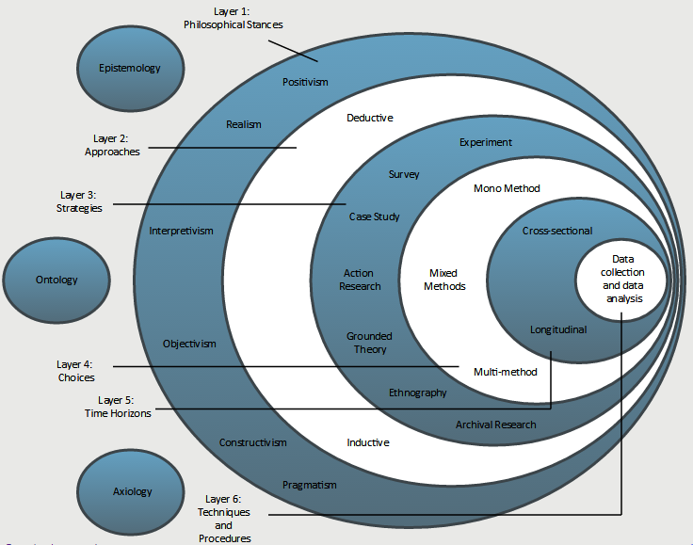
The Research Onion Metaphor
Adapted from Saunders et al., 2009; https://onion.derby.ac.uk/
Notes:
It is the researcher’s understandings and associated decisions in relation to these outer layers that provide the context and boundaries within which data collection techniques and analysis procedures will be selected. THERE ARE VARIATIONS OF THE ONION.

Slide 15
Philosophies
EPISTEMOLOGY
Epistemology is concerned with addressing the facts by asking for a definition of what is acceptable knowledge in a field of research and what information is known to be true due to rigorous testing and treated as fact.
This philosophy is most commonly used in “hard” scientific research as it searches for facts and information that can be proved without doubt rather than changeable situations and opinions.

Slide 16
Philosophies
ONTOLOGY
Ontological philosophy is concerned with the nature of reality.
It requires researchers to ask themselves how they think the world operates, how society is constructed and how this influences everything around us.
Ontology talks about the difference between reality, our perception of reality and how this influences people’s behaviour.

Slide 17
Philosophies
AXIOLOGY
Axiology allows the researcher to understand and recognise the role their values and opinion play in the collection and analysis of the research as opposed to eliminating or trying to balance the influence of it.
For example, if the researcher is a vegetarian and they are researching the availability and range of vegetarian food in hotels this must be declared in their research.
How this shapes the investigation of the issue and results analysis will need to be detailed according to the approach chosen.

Slide 18
Layer 1: Philosophical Stances
Adapted from Saunders et al., 2009; https://onion.derby.ac.uk/
Notes:
It is the researcher’s understandings and associated decisions in relation to these outer layers that provide the context and boundaries within which data collection techniques and analysis procedures will be selected.

Slide 19
Philosophical Stances
POSITIVISM (from Epistemology)
Positivism generates hypotheses (or research questions) that can be tested and allows explanations that are measured against accepted knowledge of the world we live in.
This position creates a body of research that can be replicated by other researchers to generate the same results.
The emphasis is on quantifiable results that lend themselves to statistical analysis.

Slide 20
Philosophical Stances
REALISM (from Epistemology)
Realism is similar to positivism in its processes and belief that social reality and the researcher are independent of each other and so will not create biased results.
However, where they differ is that realism thinks that scientific methods are not perfect.
It believes that all theory can be revised and that our ability to know for certain what reality is may not exist without continually researching and leaving our minds open to using new methods of research.
Realism may therefore use several types of research methods to triangulate results in their search for a more reliable outcome.

Slide 21
Philosophical Stances
INTERPRETIVISM (from Epistemology)
Interpretivism refers to approaches emphasizing the meaningful nature of people's participation in social and cultural life.
Researchers working within this tradition analyse the meanings people confer upon their own and others' actions and take the view that cultural existence and change can be understood by studying what people think about, their ideas, and the meanings that are important to them.

Slide 22
Layer 1: Philosophical Stances
Adapted from Saunders et al., 2009; https://onion.derby.ac.uk/
Notes:
It is the researcher’s understandings and associated decisions in relation to these outer layers that provide the context and boundaries within which data collection techniques and analysis procedures will be selected.

Slide 23
Philosophical Stances
OBJECTIVISM (from Ontology)
Objectivism recognises that social phenomena and their meanings exist separately to social actors.
An example of social phenomena could be heavy rain and social actors are people wanting to have a picnic outside.
The rain exists, it is real and would be acknowledged by everyone to exist and is therefore independent to the people who have had their day out ruined by it.
In your research this may be how a law (the social phenomenon) impacts on a group of people (social actors).

Slide 24
Philosophical Stances
CONSTRUCTIVISM (from Ontology)
Constructivism argues the opposite to objectivism. It is a standpoint that believes social phenomena are actually constructed by social actors.
So, if you had a constructive ontological worldview you would believe that, for example, a new law is the product of the behaviour of the group of people it now has an impact on.

Slide 25
Philosophical Stances
PRAGMATISM (from Ontology)
Pragmatism argues that both constructivism and objectivism are valid ways to approach research.
Pragmatism allows a researcher to view the topic from either or both points-of-view regarding the influence or role of social actors and uses these to create a practical approach to research.
This may be used to find solutions to problems.

Slide 26
Layer 2: Approaches
Adapted from Saunders et al., 2009; https://onion.derby.ac.uk/
Notes:
It is the researcher’s understandings and associated decisions in relation to these outer layers that provide the context and boundaries within which data collection techniques and analysis procedures will be selected.

Slide 27
Approaches
DEDUCTIVE
Deductive means that you start with a statement/hypothesis or question and your research sets out to answer it.
Questions and hypothesis may be derived from informed speculation about the topic, that the researcher believes can be answered or tested.
The thought process of deduction moves from theory to the research question, to data collection, findings and a rejection or confirmation of the hypothesis or answer to the question.
This could lead onto a revision of the theory and often starts the process over again.

Slide 28
Approaches
INDUCTIVE
Inductive means that you are researching to create theory.
The process moves in the opposite direction to the deductive approach, where the focus is not the existing theory.
This means the research goes from research question to observation and description, to analysis and finally theory.
Therefore if little research exists on a topic then an inductive approach may be the best way to proceed.

Slide 29
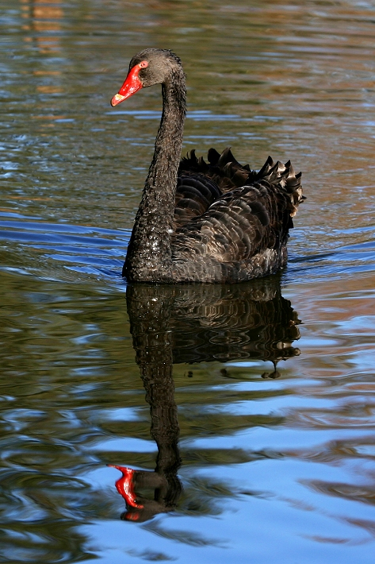
Approaches
Inductivism:
General statements (theories) have to be based on empirical observations, which are subsequently generalized into statements which can either be regarded as true or probably true.
The classical example goes from a series of observations:
Swan no. 1 was white,
Swan no. 2 was white,
Swan no. 3 was white,…
to the general statement: All swans are white.

Slide 30
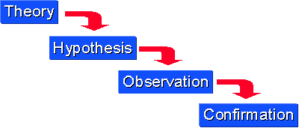
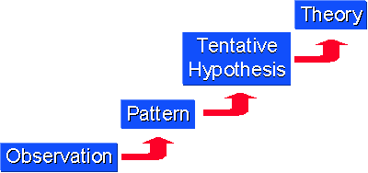
Approaches
Deduction
Induction

Slide 31
Approaches
Induction
Deduction
Observe phenomena and record them.
Study data recorded for possible patterns and regularities.
Seek explanation(s) to such patterns where they exist.
This is where a theory that explains what has been discovered can emerge.
Provides strong evidence for conclusion.
Movement from a theory to specific observations
On the basis of a theory, an investigator predicts certain phenomena.
Next, the investigator observes and collects data to ascertain whether the phenomena occur as predicted.
Links premises to conclusions.

Slide 32
Approaches
Scientific Research involves both deduction and induction.
May start with a theory and deduce certain phenomena that the researcher then sets out to observe.
If successive observations do not fit the theory, then the theory can be revised and, ultimately, rejected.
Observations then lead to a new theory through induction.
However, single projects will often use just use one approach
Time-frame, resources…

Slide 33
Choice of Research Strategy…
Based on:
Epistemology (How should we be attempting to assess knowledge?)
Positivism = explain a phenomena
Interpretivism = understand a phenomena
Ontology (Does the data exist in a tangible or an intangible form?)
Objectivism = explain independent external outcomes
Constructionism = understand how social factors interact

Slide 34
Choice of Research Strategy…
Study in the natural sciences often requires a positivistic epistemology and an objectivistic ontology
Study in the social sciences often requires an interpretive epistemology and a constructionist ontology
However, it is occasionally possible to combine these strategies by coding qualitative data quantitatively (i.e. Athlete = 1 ; Non-Athlete = 2)

Slide 35
Layer 3: Strategies
Adapted from Saunders et al., 2009; https://onion.derby.ac.uk/
Notes:
It is the researcher’s understandings and associated decisions in relation to these outer layers that provide the context and boundaries within which data collection techniques and analysis procedures will be selected.

Slide 36
Strategies
EXPERIMENT
Experimental designs are more rigid in their structure and process to enable the research to be replicated.
These designs test the causal effects of phenomena on a group compared to a control group who are not subjected to any phenomena.
The causal effect is from the independent variable on the dependent variable.
Experimental strategies generate data that can be statistically analysed.
Aims to examine the results of an experiment against the expected results and usually involves the consideration of a relatively limited number of factors.
Notes:
// clinical trials, chemistry, physics

Slide 37
Strategies
SURVEY
A survey strategy is often associated with a deductive approach.
It offers the researcher a highly economical way of collecting large amounts of data to address the who, what, where, when and how of any given topic or issue.
This strategy can generate both rich (words) and statistical data.
Surveys involve sampling a representative proportion of the population.
Surveys often produce quantitative data that can be analysed empirically, to examine causative variables.

Slide 38
Strategies
CASE STUDY
Case study design involves extensive study of one or more individuals or cases in a real-life context.
The data that is collected may include: watching aspects of their behaviour or of the setting, interviews with participants and record searching.
The goal is to establish the key features and draw generalisations, offering an insight into the specific nature of any example, and establish the importance of culture and context in differences between restricted cases.

Slide 39
Strategies
ACTION RESEARCH
This strategy is characterised as a problem-solving approach to a specific research problem within a community of practice.
As part of this search for a solution the strategy allows the researcher to be part of the organisation or case study that requires the solution. It allows for collaboration between the topic organisation and the researcher.
The process of Action Research moves from a clear objective to diagnosis of the problem and generation of a list of actions to solve the problem and establishing that it corresponds to the best approach.
It tends to involve reflective practice, which is a systematic process by which the professional practice and experience of the practitioners can be assessed.

Slide 40
Strategies
GROUNDED THEORY
Grounded Theory uses inductive methods to predict and explain behaviour to build theory.
This starts with data being collected from observation, theory and predictions being generated from that data and then those predictions being tested.
This strategy, although generating new theory, is still grounded by existing theory and literature on the topic.
Its use is common in the social sciences.

Slide 41
Strategies
ETHNOGRAPHY
Ethnography is rooted in anthropology, which is the study of others from a detached point-of-view.
However, ethnography requires the researcher to be a part of the community or situation they are researching.
It aims to understand the differences of meaning and importance or behaviours from their perspective.
This may be time consuming for the researcher to achieve full integration into a social scene to experience and document long-term changes in actions and opinions.
Notes:
// living among gorillas

Slide 42
Strategies
ARCHIVAL RESEARCH
This strategy centres its data collection on existing data sets or archive documents.
This allows for exploratory, explanatory or descriptive analysis of changes tracked over a long period of time.
However, the accuracy and breadth of information available may be an issue for a researcher relying solely on this type of secondary data.
Notes:
// history

Slide 43
Layer 4: Choices
Adapted from Saunders et al., 2009; https://onion.derby.ac.uk/
Notes:
It is the researcher’s understandings and associated decisions in relation to these outer layers that provide the context and boundaries within which data collection techniques and analysis procedures will be selected.

Slide 44
Choices
QUANTITATIVE / QUALITATIVE
Choices regarding HOW you wish to use quantitative and qualitative methods in your research.
Quantitative and qualitative research methods do not have a layer of their own in the research onion diagram, as they should be continually considered as you travel through to the centre.

Slide 45
Choices
QUANTITATIVE / QUALITATIVE
Quantitative research involves numbers. It is concerned with quantity and measurements. Relies heavily on statistical data collected through empirical observation or from statistical digests.
Analysed through the use of statistical tools with a view to testing hypotheses and offering explanations
Qualitative research is concerned with rich data such as personal accounts, opinions and description. Relies more on data that are in the form of words rather than numbers.
Categorized into themes and evaluated with a view to describing or discovering phenomena.

Slide 46
Choices
MONO-METHOD
Mono-method research is when either quantitative or qualitative data is collected rather than a combination of both.
This may be due to the demands of the philosophy, philosophical choices and strategies employed.
It could also be used to research an opposing view to existing mono-method research.

Slide 47
Choices
MULTI-METHOD
When multiple types of qualitative or multiple types of quantitative data are collected
But only one choice: quantitative or qualitative

Slide 48
Choices
MIXED-METHODS
Mixed-methods research is when the researcher uses both quantitative and qualitative methods in data collection and analysis.
It can be argued that by combining both types of research, the limitations of each individual method can be offset and gaps of data can be filled or predicted.
You should decide whether you will use them equally or with one more dominant than the other.

Slide 49
Layer 5: Time Horizons
Adapted from Saunders et al., 2009; https://onion.derby.ac.uk/
Notes:
It is the researcher’s understandings and associated decisions in relation to these outer layers that provide the context and boundaries within which data collection techniques and analysis procedures will be selected.

Slide 50
Time Horizons
CROSS-SECTIONAL
Cross-sectional designs can use qualitative and/or quantitative research and they measure an aspect or behaviour of many groups or individuals and at a single point in time.
Short-term study.
LONGITUDINAL
Longitudinal designs can also use qualitative and/or quantitative research but they study events and behaviours using concentrated samples over a longer period of time.

Slide 51
Layer 6: Techniques and Procedures
Adapted from Saunders et al., 2009; https://onion.derby.ac.uk/
Notes:
It is the researcher’s understandings and associated decisions in relation to these outer layers that provide the context and boundaries within which data collection techniques and analysis procedures will be selected.

Slide 52
Data collection and analysis
METHODS
Methods are the ways in which you will actually design and collect data.
TOOLS
You may also consider the tools for the effect.

Slide 53
Data collection and analysis
METHODS
TOOLS
Questionnaire
// survey
Paper
Online
Survey Monkey
Google Forms
SPSS
Excel
ANALYSIS
Statistical

Slide 54
Data collection and analysis
METHODS
TOOLS
Interview
// survey
Face to face
Remote
Telephone
Skype
ANALYSIS
Words and meaning
Content, themes, discourse
Coding
Selective quoting
Profile building

Slide 55
Data collection and analysis
METHODS
TOOLS
Observational survey
Cameras
Note taking software
OneNote
ANALYSIS
Frequency of occurrence of events
Statistical
Context/profile/qualitative

Slide 56
Data collection and analysis
METHODS
TOOLS
Experiment
Comparative
Descriptive Statistics
Correlational
Regressions
Numeric data
Classification Models
Categorical data
Excel
SPSS
Programming
Matlab
R
Python
Machine Learning
Decision Trees
SVM
ANN
Bayes Classifiers
K-nearest neighbours
ANALYSIS
Statistical

Slide 57
Data collection and analysis
METHODS
TOOLS
Formal Modelling
Analytical
Mathematical
Stochastic
Simulation
// experiment
Mathematics editors
Simulation Packages
GPSS
ANALYSIS
Statistical

Slide 58
Data collection and analysis
METHODS
TOOLS
Pilot case
Prototype
Proof of concept
// case study, action research
Software Development and Deployment
OOP
Java, C++…
Web
HTML, CSS, JavaScript, PHP…
SQL databases
MySQL, Oracle…
noSQL
MongoDB
Mobile
Android, iOS…
ANALYSIS
Lessons learned
Feasibility
Context

Slide 59
Data collection and analysis
METHODS
TOOLS
Project monitoring
Agile
Waterfall
RUP
// case study, action research
CASE tools
Visio
Generic Packages
Microsoft Project
Gantt charts
Specific methodologies
SCRUM
Burndown charts
Sprint backlog
Sprint review
ANALYSIS
KPIs

Slide 60
Data collection and analysis
METHODS
TOOLS
Systematic literature reviews
// archival research
Reference managers
Zotero
Mendeley
EndNote
Note taking software
OneNote
ANALYSIS
Annotated bibliographies

Slide 61
Activity
Use last week’s sample paper and, in groups, place the study within the layers of the “research onion”:
Data collection and data analysis
Quantitative and/or qualitative choices
Strategies
Inductive or deductive approaches
Philosophical stances

